Slide 1




Speaker
Nathan Clouse
Technical Architect
Microsoft MVP 5x
Armanino AtomicAX.com Dynamics.fo

Slide 2



Intro
Identify areas we can improve and act on our own
Collect info on areas we want help improving
Areas we can improve with admins and developers

Slide 3
What Microsoft Delivers
A good product using good technology that delivers good results with good performance
Its up to us to make it great for our organization

Slide 4
Identifying Issues
Visible
Slow Screens or reports
Excel Add-in going slow
Waiting
Not-So-Visible
Batch jobs
DMF
Integrations

Slide 5
Forms
If a form is slow…
Remove some columns
Don’t use it? Don’t need it!

Slide 6
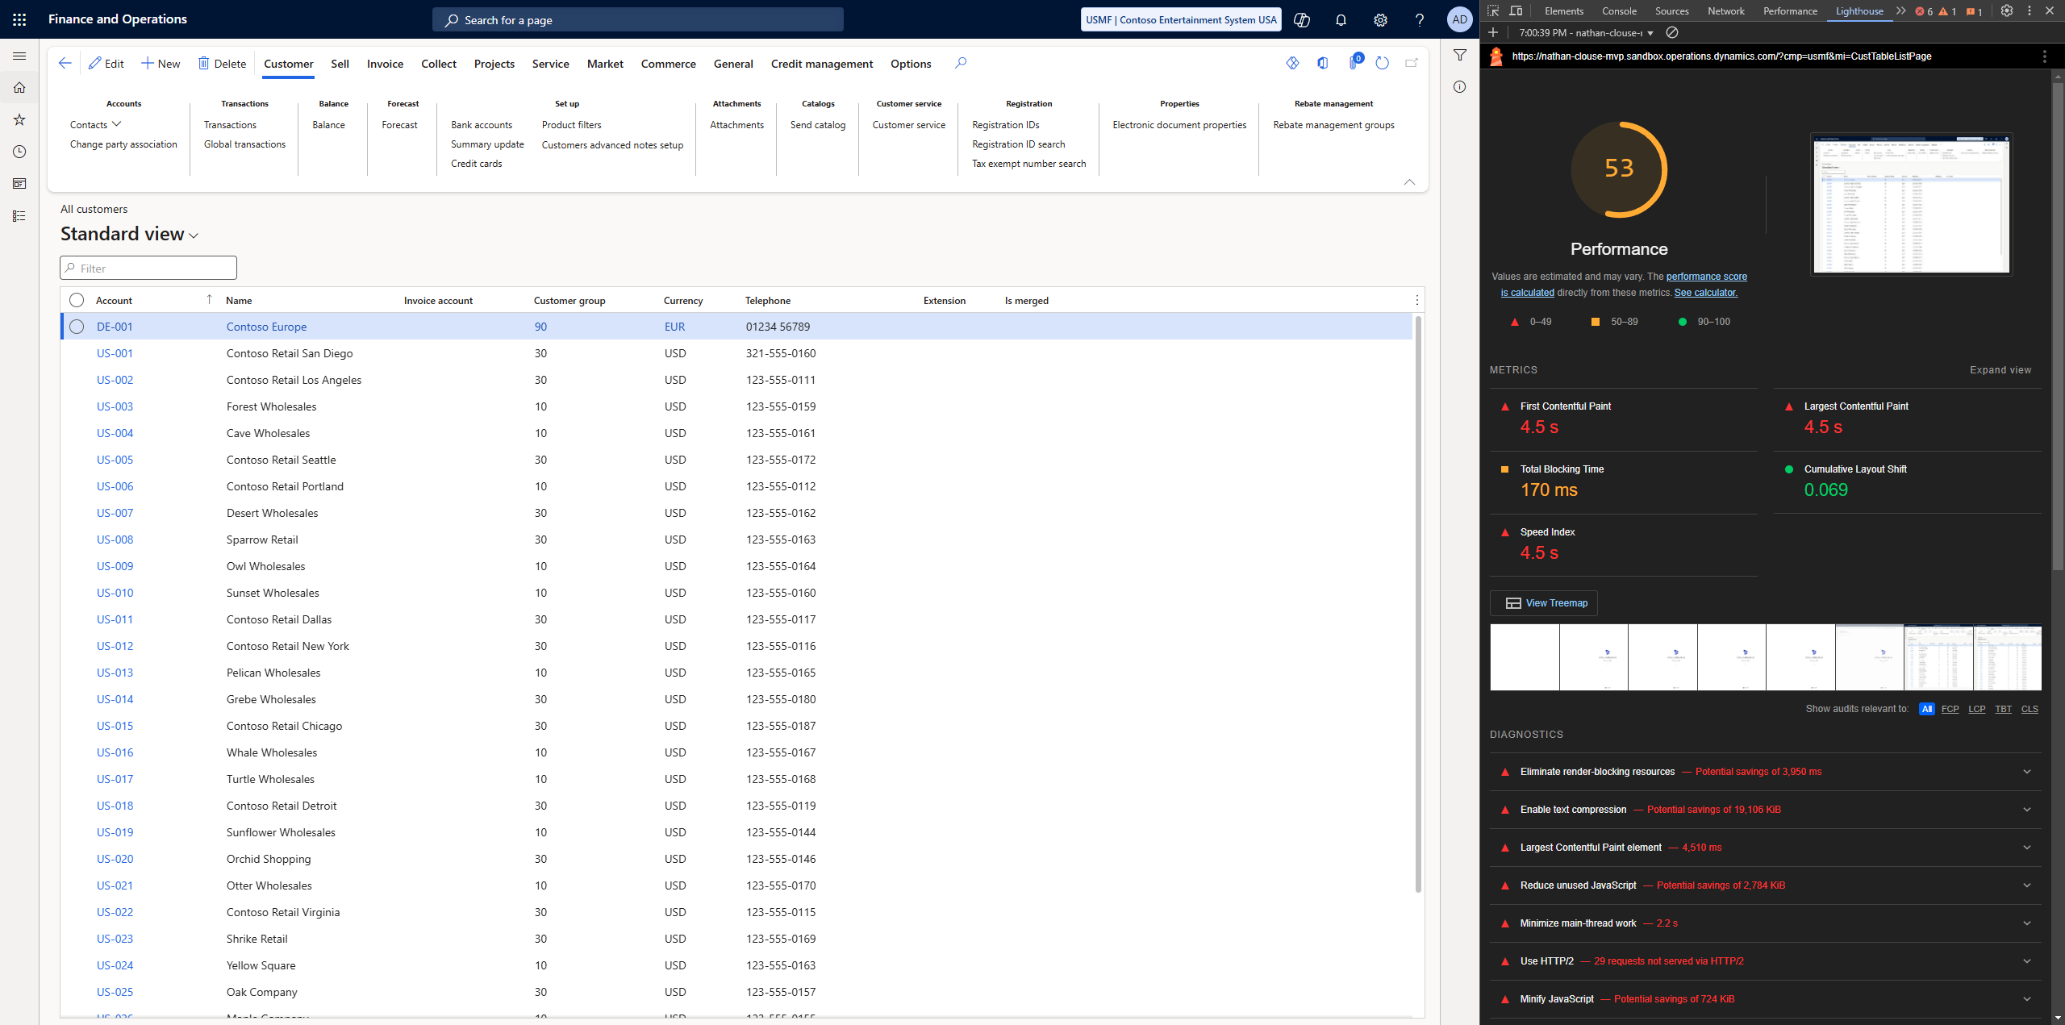

Slide 7
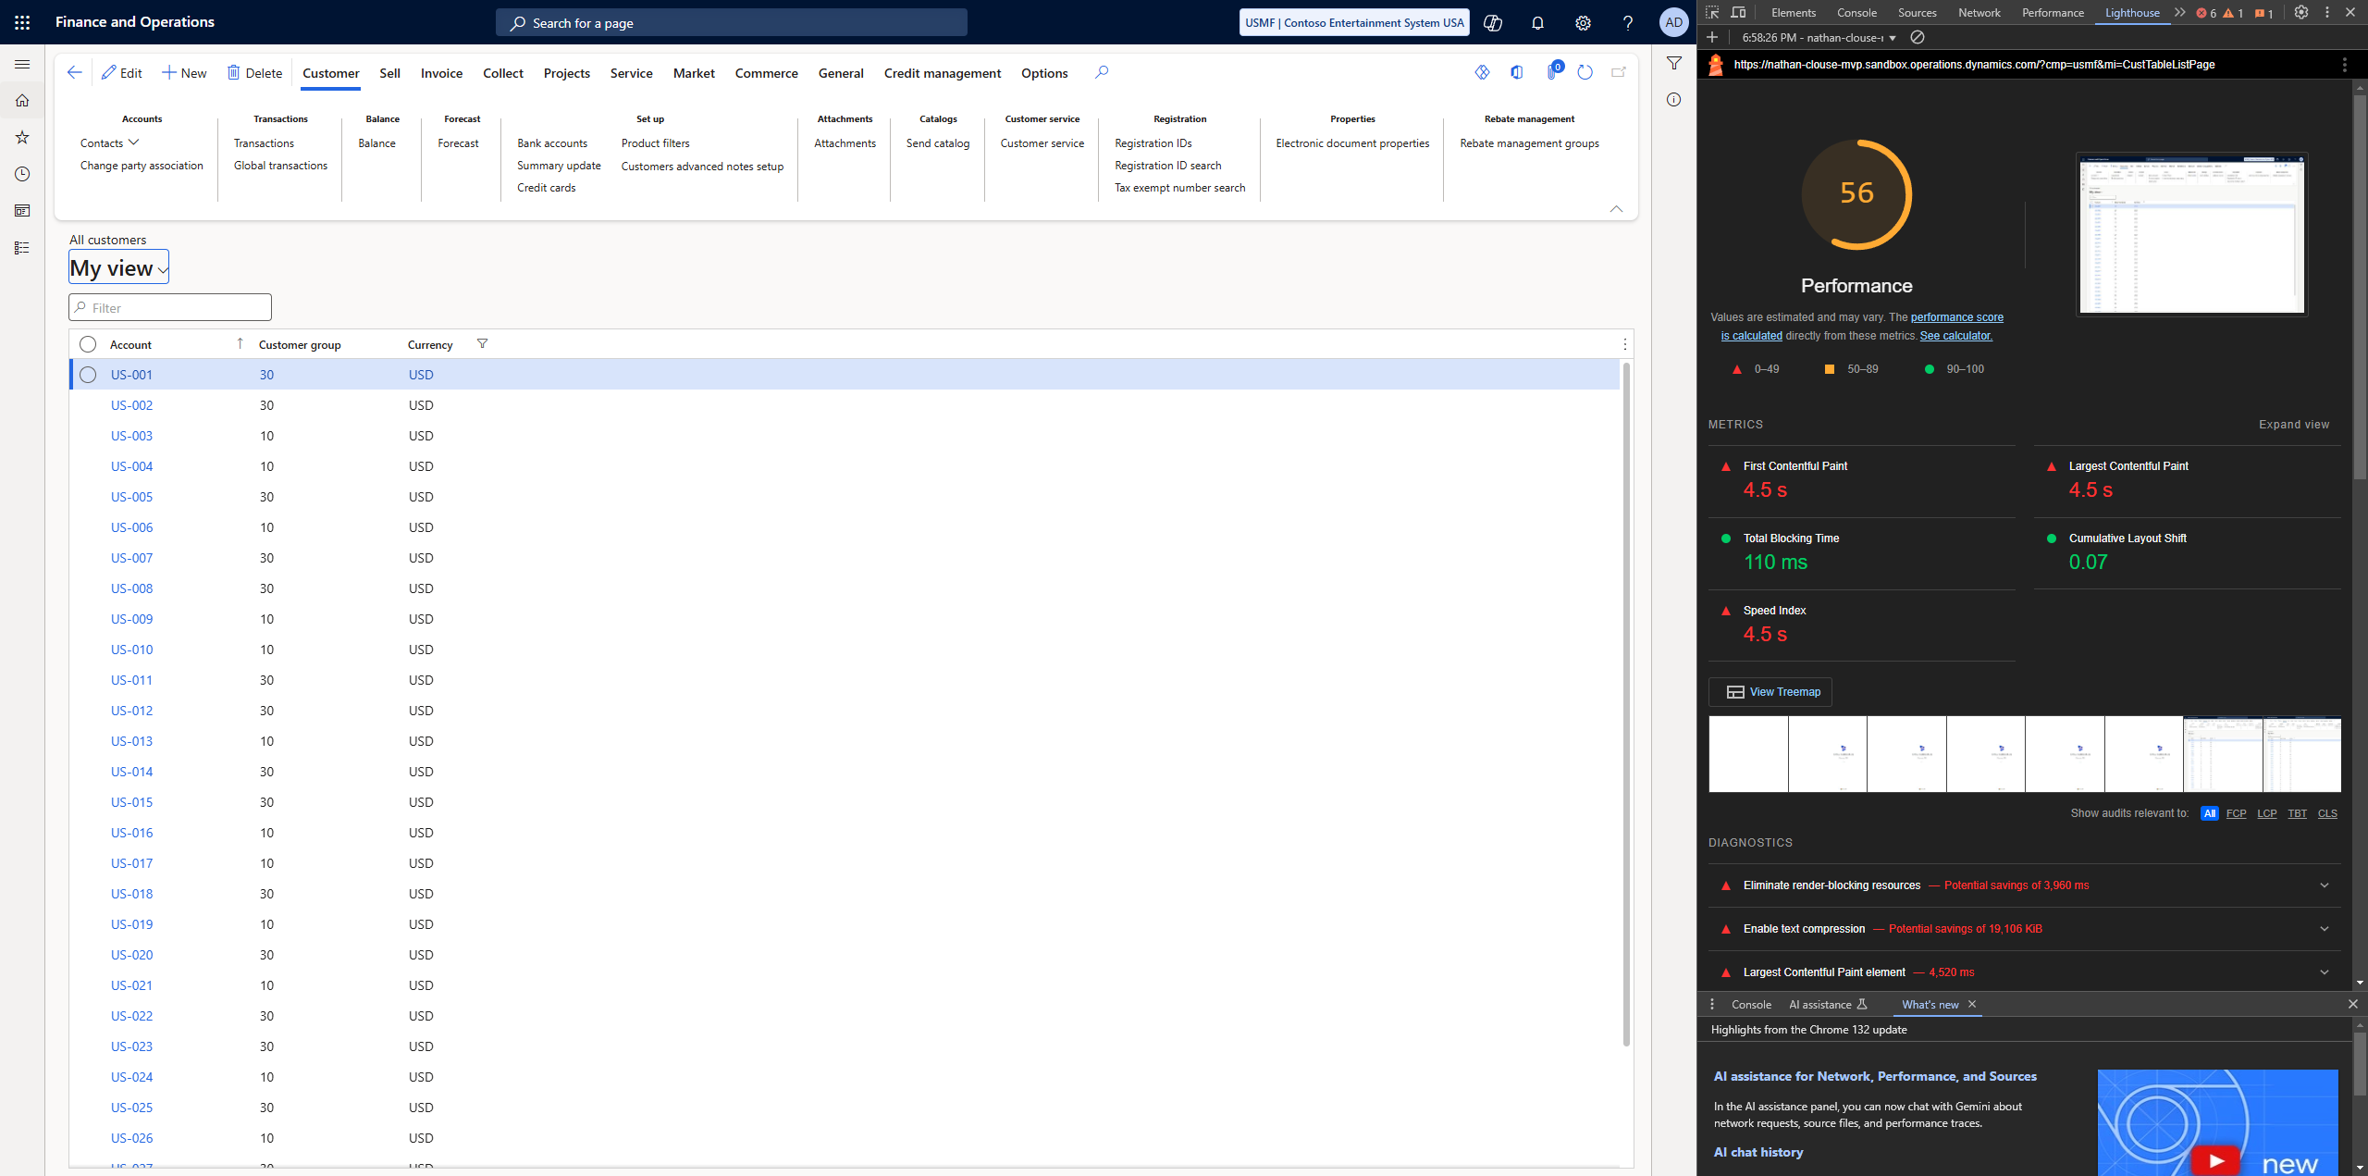

Slide 8
Workspaces
If you have common views you use or have a lot you want to use…
Make a workspace
Home page > right click in workspaces > personalize workspaces > Add pages > Workspace

Slide 9
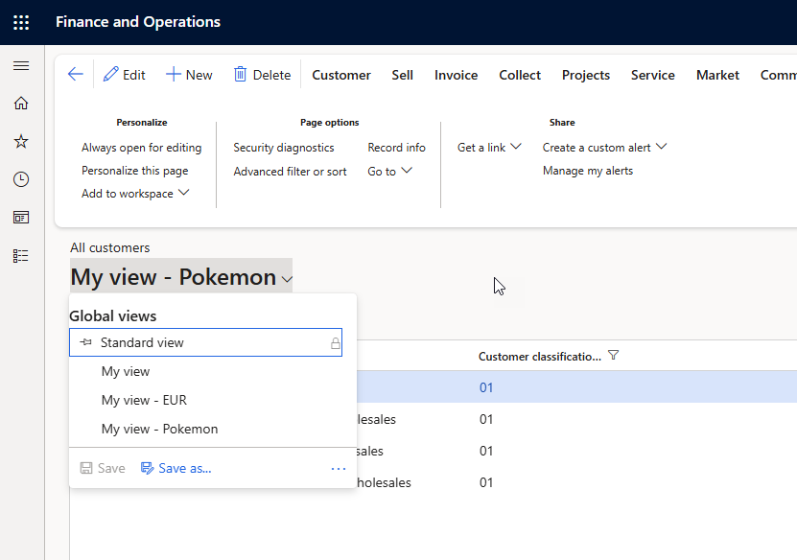

Slide 10
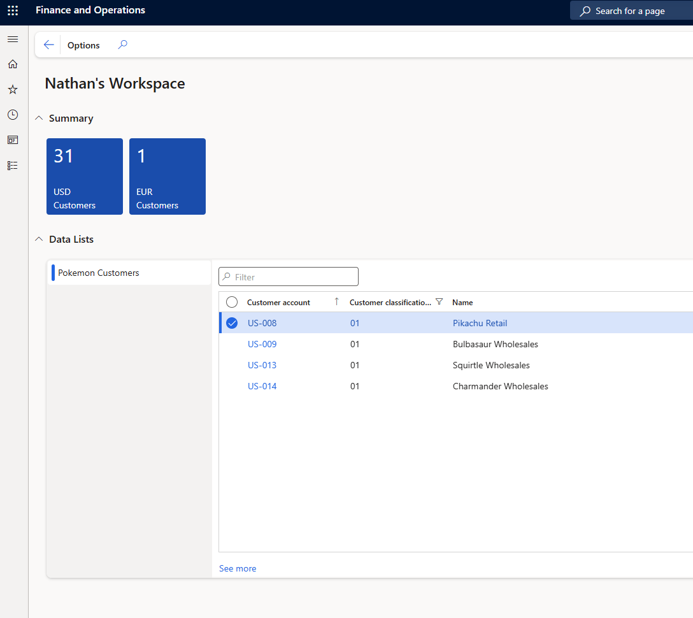

Slide 11
Excel Add In
The Excel add in can be clunky and slow
First, see if any new data entities are available
Next, see if any other data entities are available that are faster

Slide 12
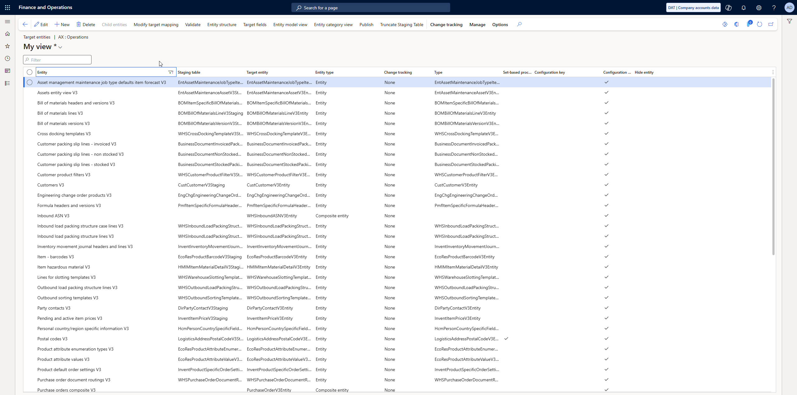

Slide 13
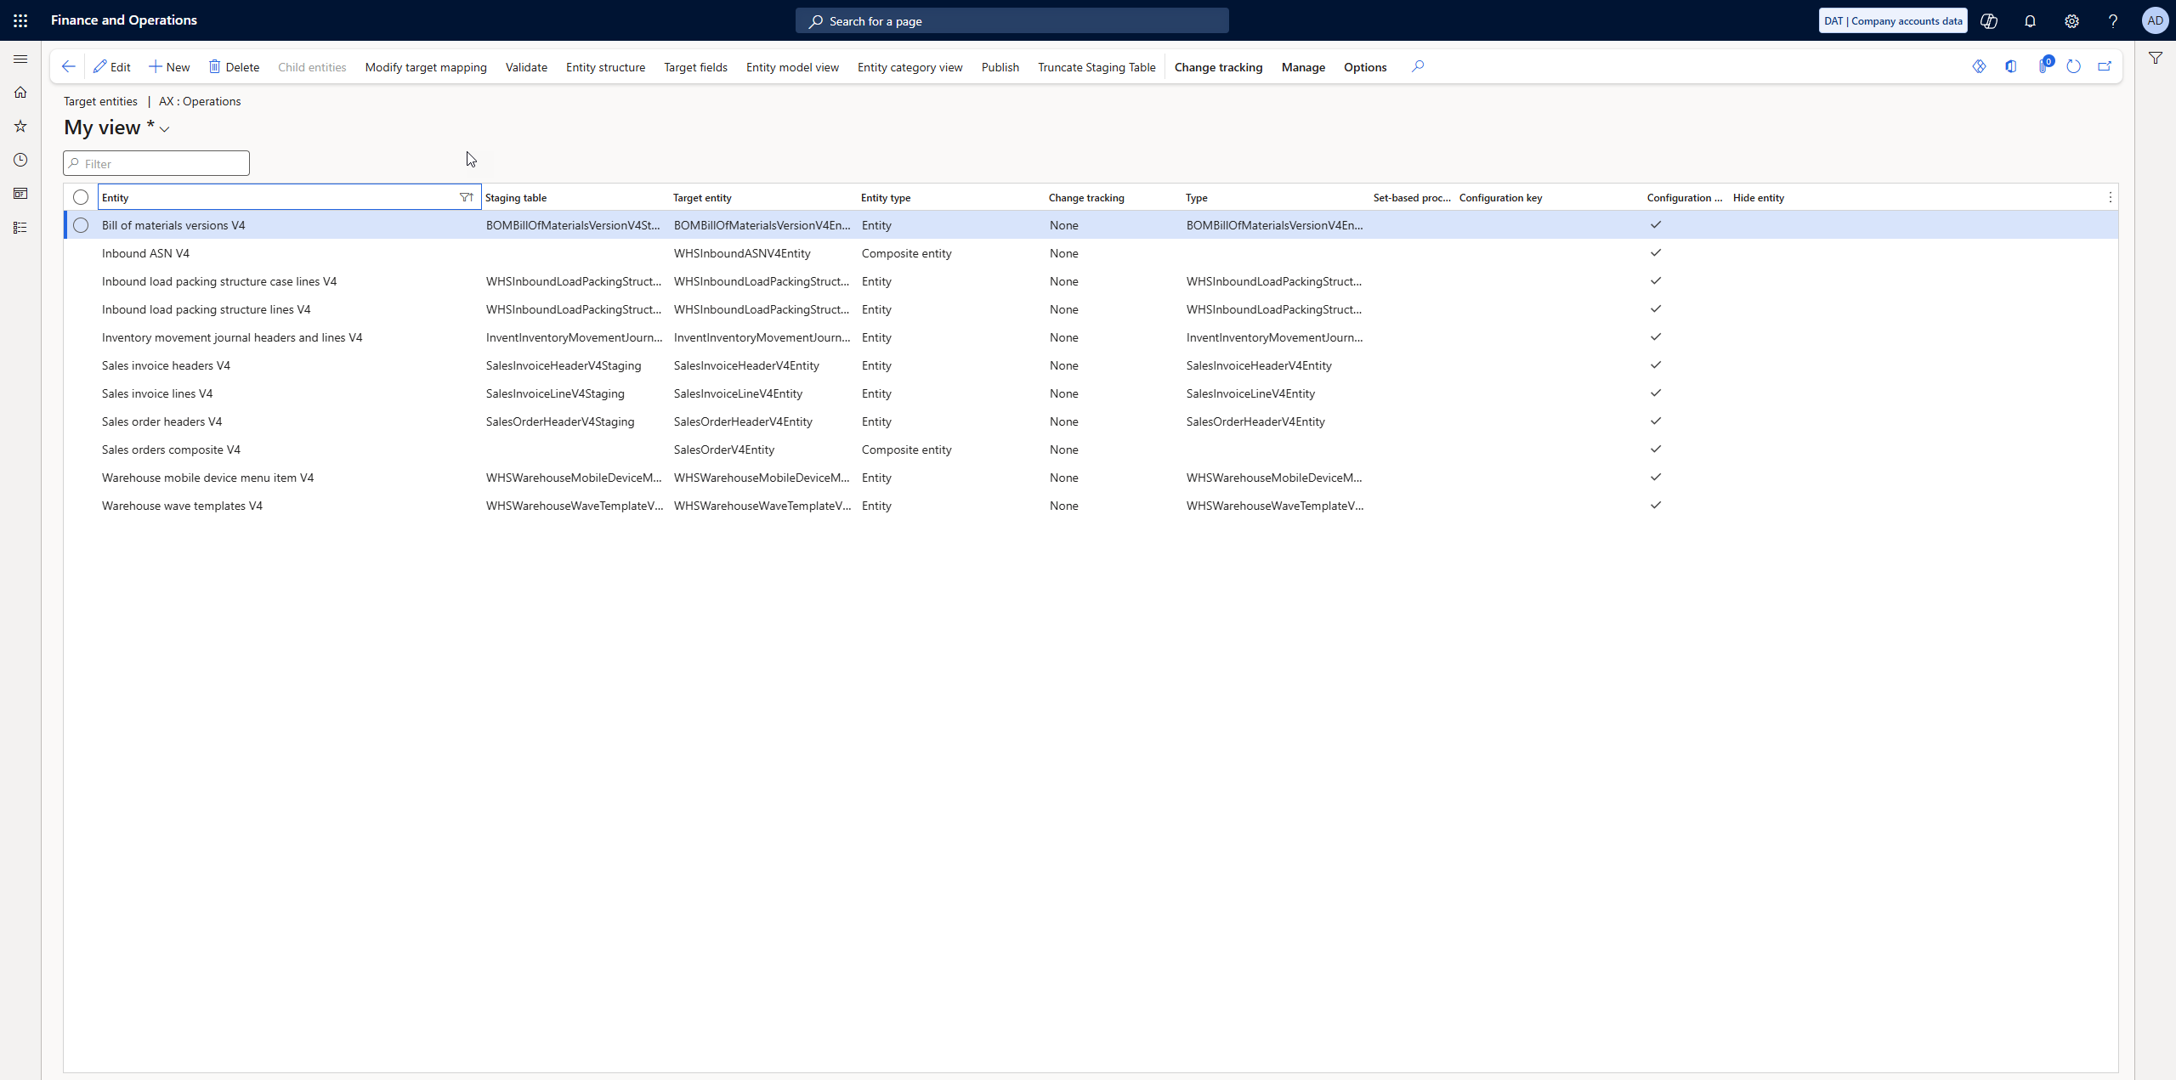

Slide 14
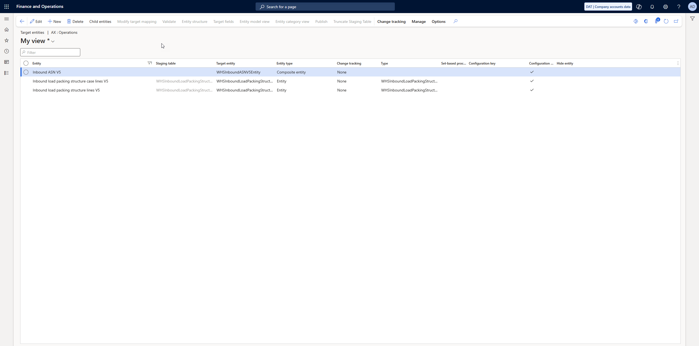

Slide 15
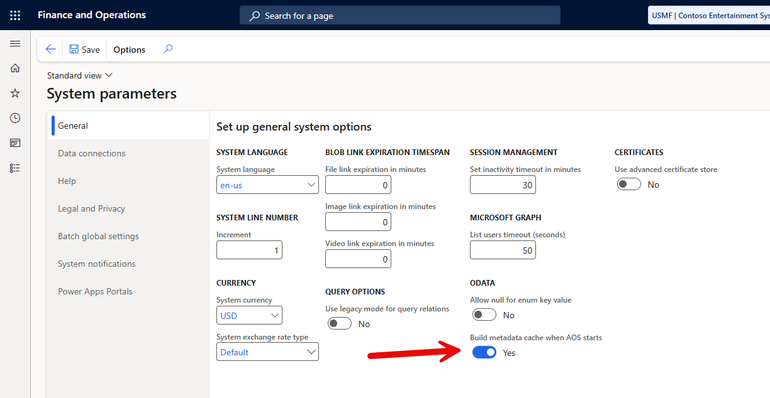

Slide 16
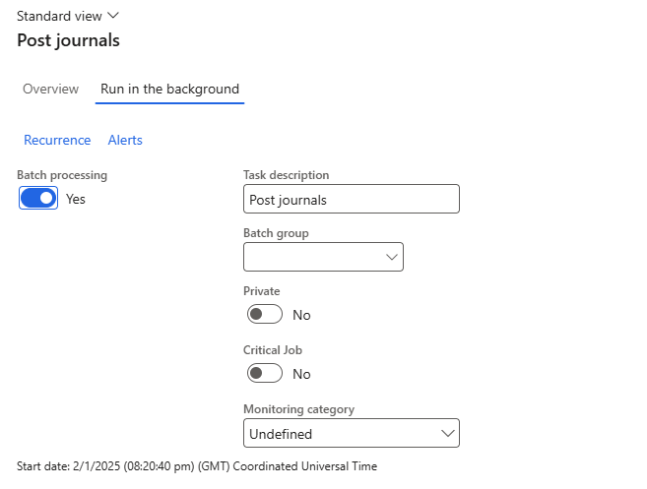
Waiting?
If you’re waiting, is using batch an option?

Slide 17
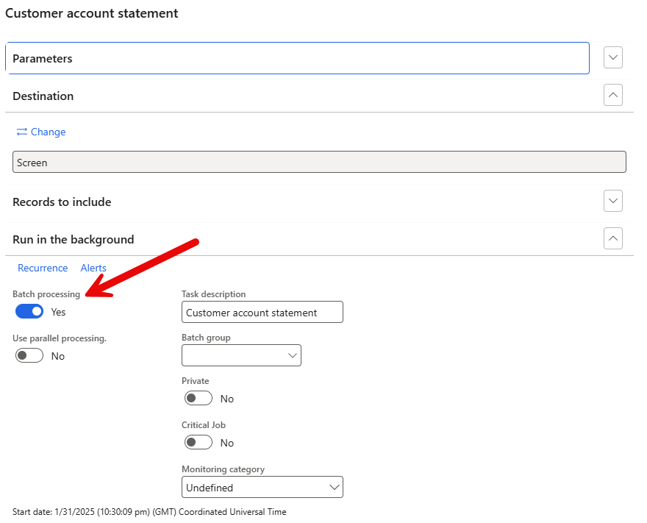

Slide 18
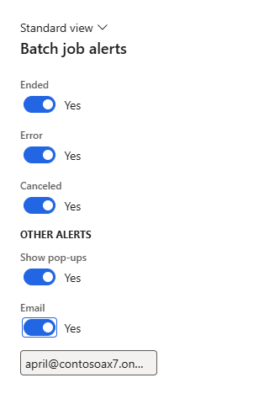

Slide 19
Batch Jobs ( and History )
Identify long running batch jobs and review history
System Administration > Inquiries > Batch Jobs
System Administration > Workspaces > System Administration

Slide 20
Menu Item Hack
https://nathan-clouse.sandbox.operations.dynamics.com/?cmp=usmf&mi=BatchJob
https://nathan-clouse.sandbox.operations.dynamics.com/?cmp=usmf&mi=BatchJobHistory

Slide 21
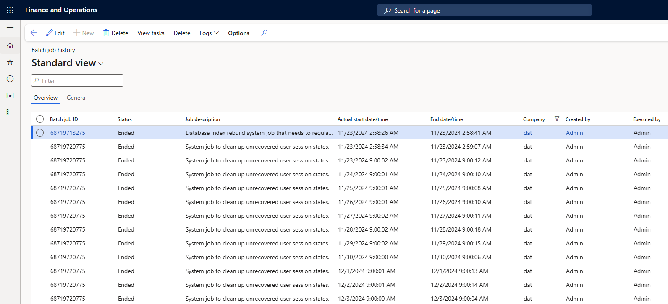

Slide 22
DMF
If DMF is slow, run cleanup
This cleans up data that most likely isn’t needed
Databases with less data typically are faster

Slide 23
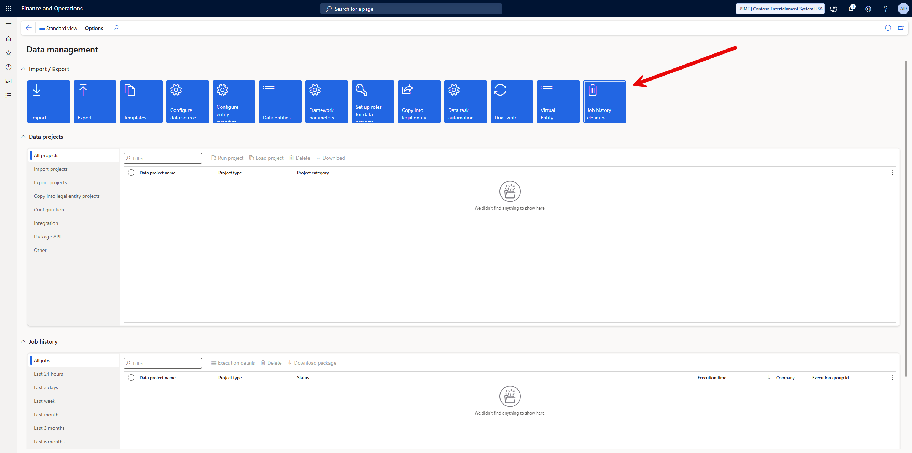

Slide 24
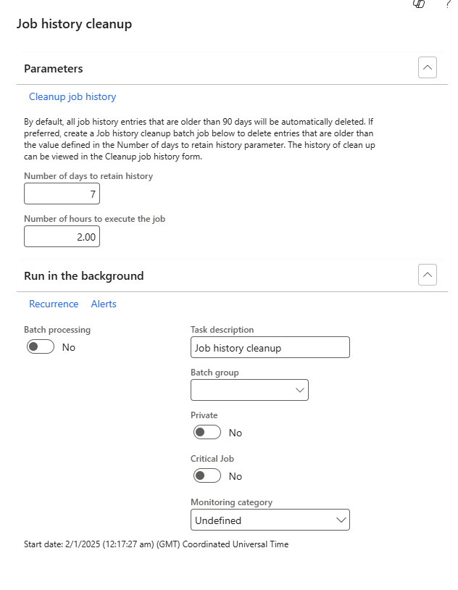

Slide 25
Short Chat about Capacity
Storage Capacity
Database Usage
Blob Usage
Nothing to do with system performance
Batch Capacity
Threads available
Batch Job Tasks that are available to run
Amount of resources dedicated to batch workload

Slide 26
Integrations
DMF, Custom Services, and OData
LCS tools are being removed so some visibility is limited
Endpoints aren’t managed so no layer there to help either
Use Azure API Manager for API Endpoints
Limitations from LCS on logging – no automation

Slide 27
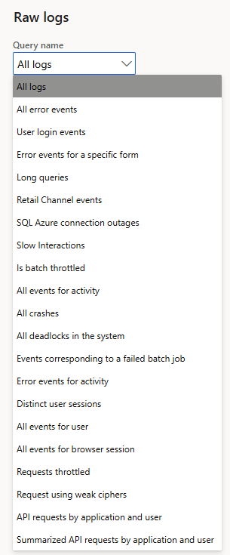
LCS
Going away in the future
Replaced with Power Platform Admin Center (PPAC)

Slide 28
Telemetry
https://community.dynamics.com/blogs/post/?postid=b8014884-9aa3-4fdb-8e2a-b3440d01a79a
https://alexdmeyer.com/2023/10/03/using-telemetry-data-for-read-auditing-in-d365fo/
https://github.com/microsoft/Dynamics-365-FastTrack-FSCM-Telemetry-Samples

Slide 29
Task Recorder
Tools > Task Recorder > Start
Collects button clicks, form opens, etc. for “thing that is slow”

Slide 30
“Performance Report”
Task Recording
Include Word Doc, Developer recording, and .axtr
Include the legal entity/company, date and time of day with time zone
Use Teams to record your screen if you can ( have a meeting with yourself )

Slide 31
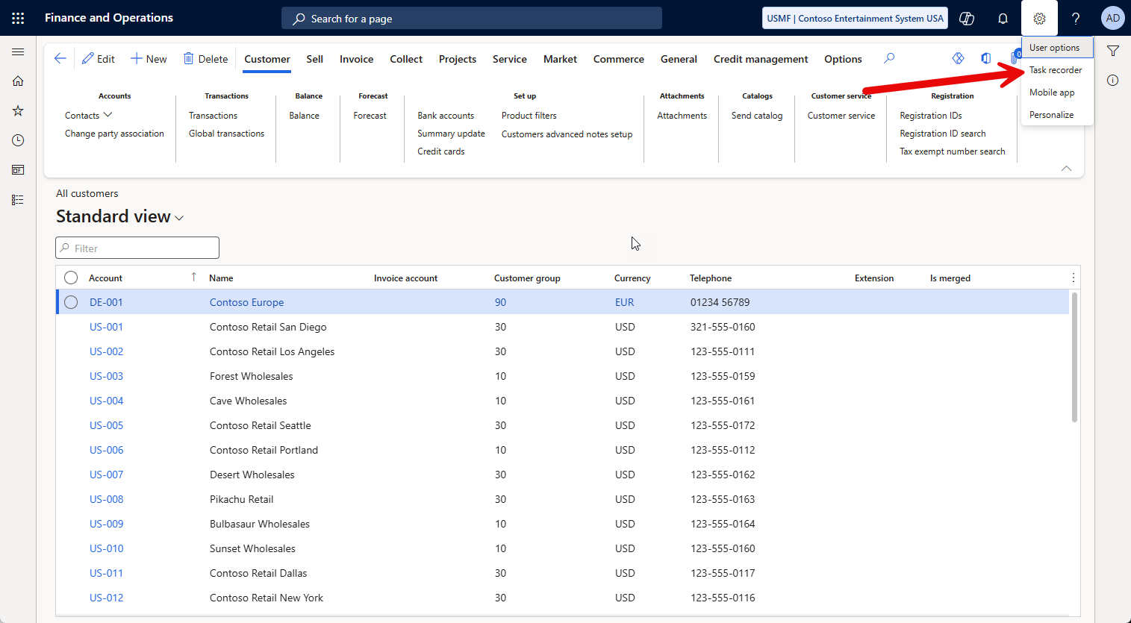

Slide 32
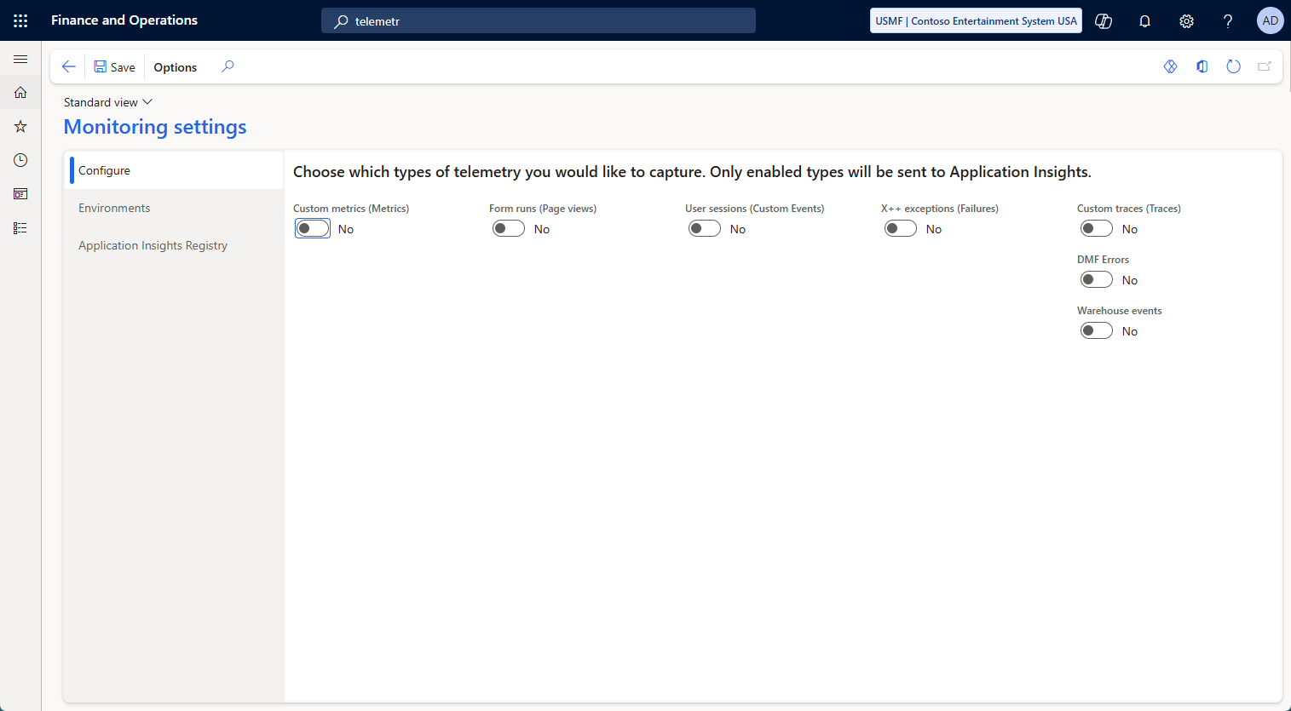
Telemetry
Turn on telemetry
Custom Metrics
Form runs ( Page Views)
User Sessions
X++ exceptions
Custom Traces
DMF Errors
Warehouse events
Add your own

Slide 33
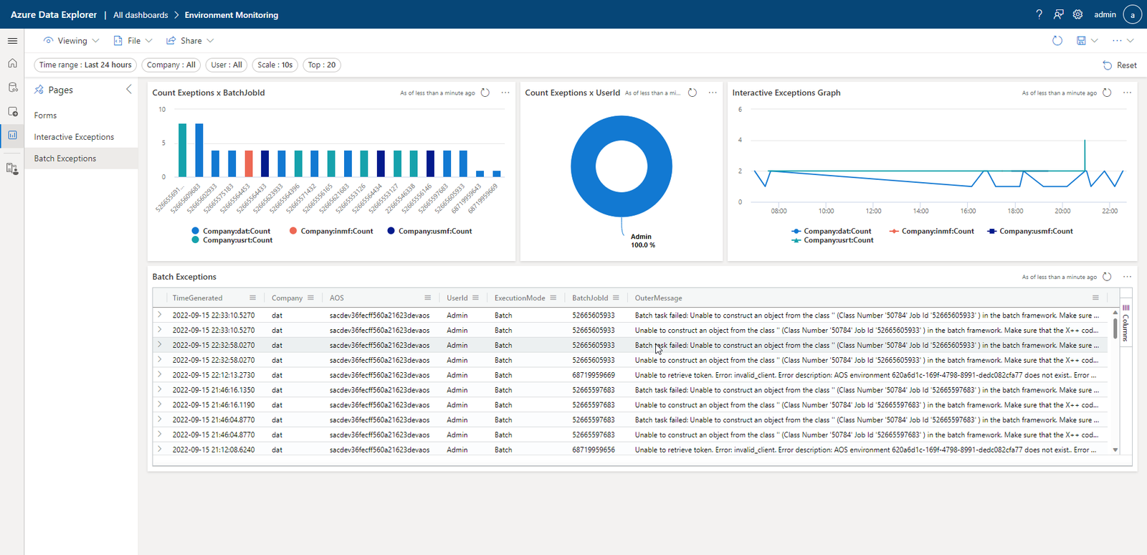
Notes:
Credit: https://samuelardilacarreno.com/2022/09/17/monitoring-and-telemetry-for-dynamics-365-finance-and-operations/

Slide 34
LCS
Limited insight
Reducing functionality over time
No automation available for most logging functionality
Slow

Slide 35
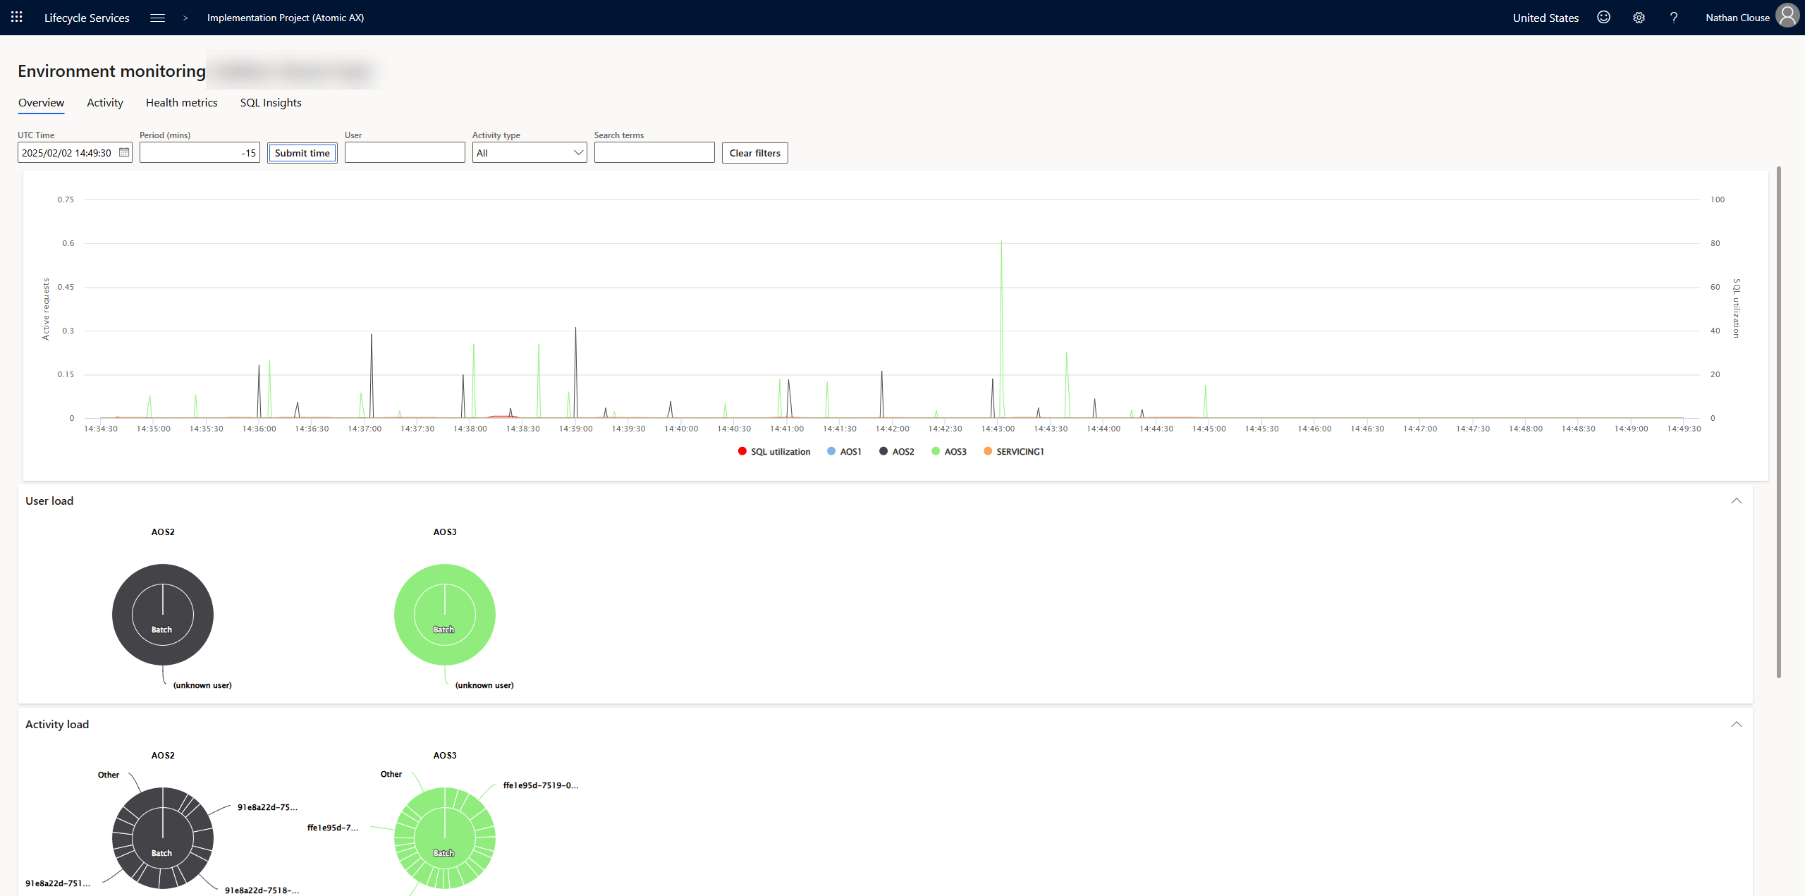

Slide 36
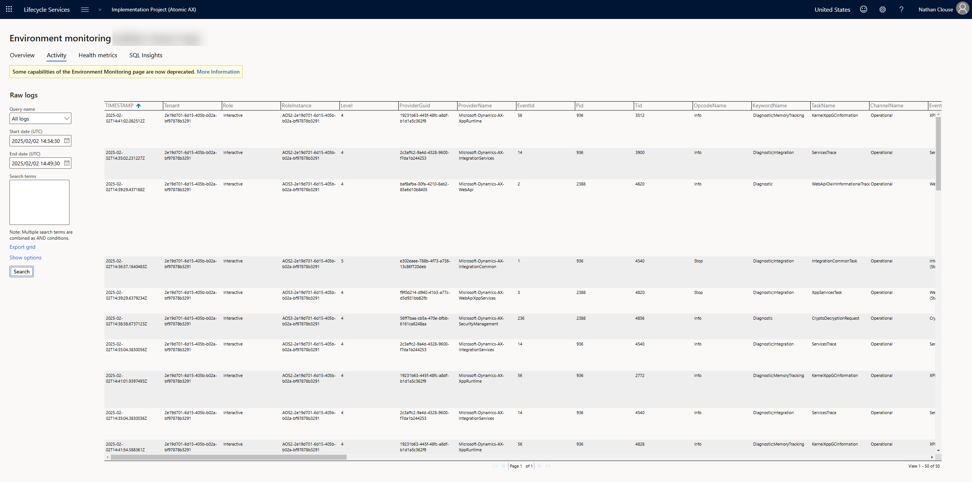

Slide 37
LCS

Slide 38
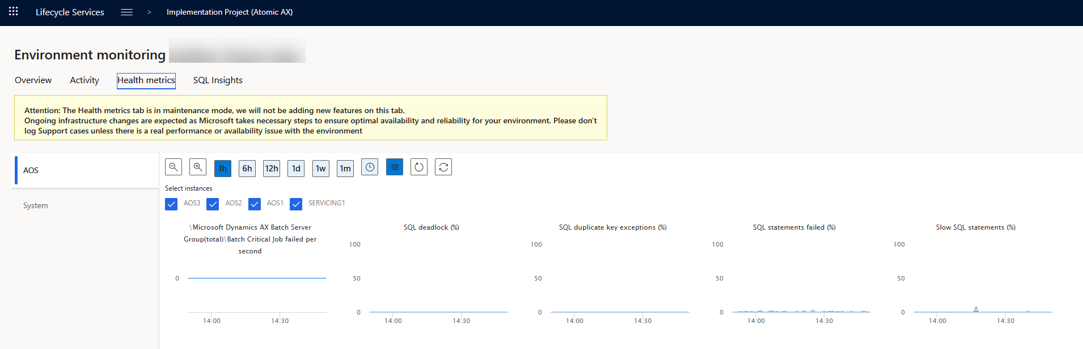

Slide 39
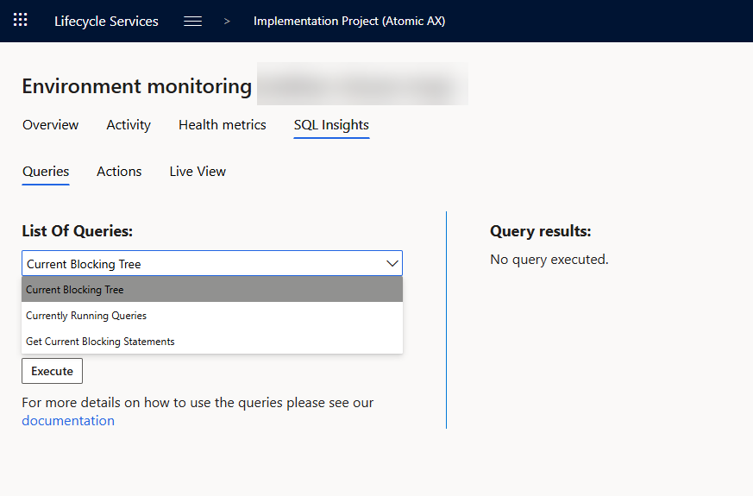

Slide 40
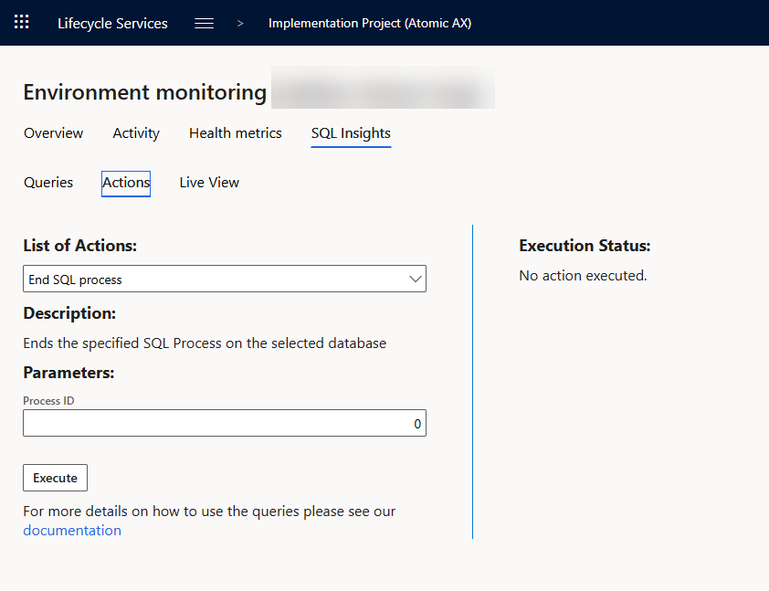

Slide 41
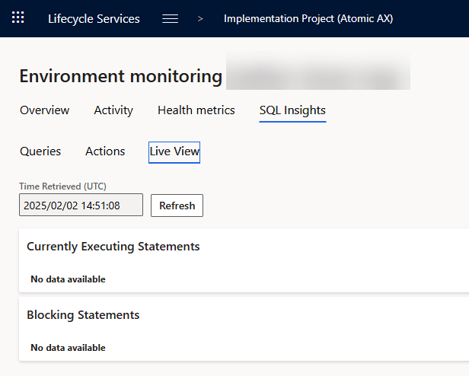

Slide 42
Trace Parser
What is a trace?
Detailed log of events, system calls, SQL queries, and resource usage captured while a specific task is being executed
Help > Trace

Slide 43
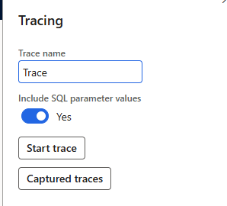
Trace Parser
SQL Parameters
Gives more insight, “costs” a little more when on
Only admins can see previous traces
Users need “System Tracing user” to capture a trace

Slide 44
Parsing A Trace
Found on VHD and VMs.
“Microsoft Dynamics 365 Unified Operations - Trace Parser” in start menu
In UDE assets

Slide 45
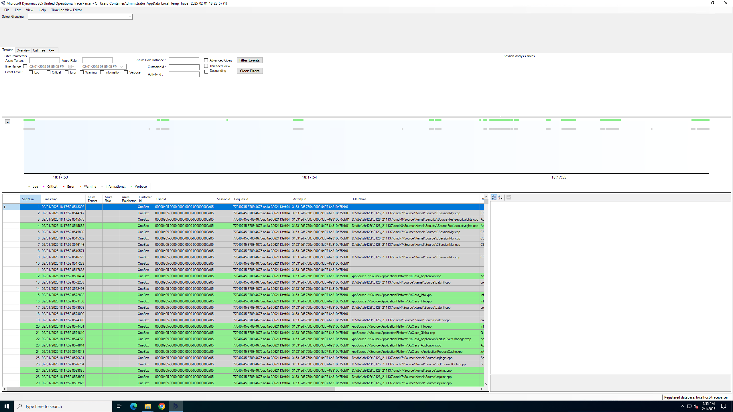

Slide 46
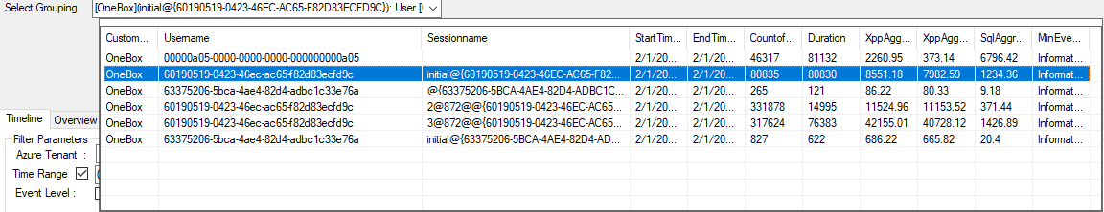

Slide 47
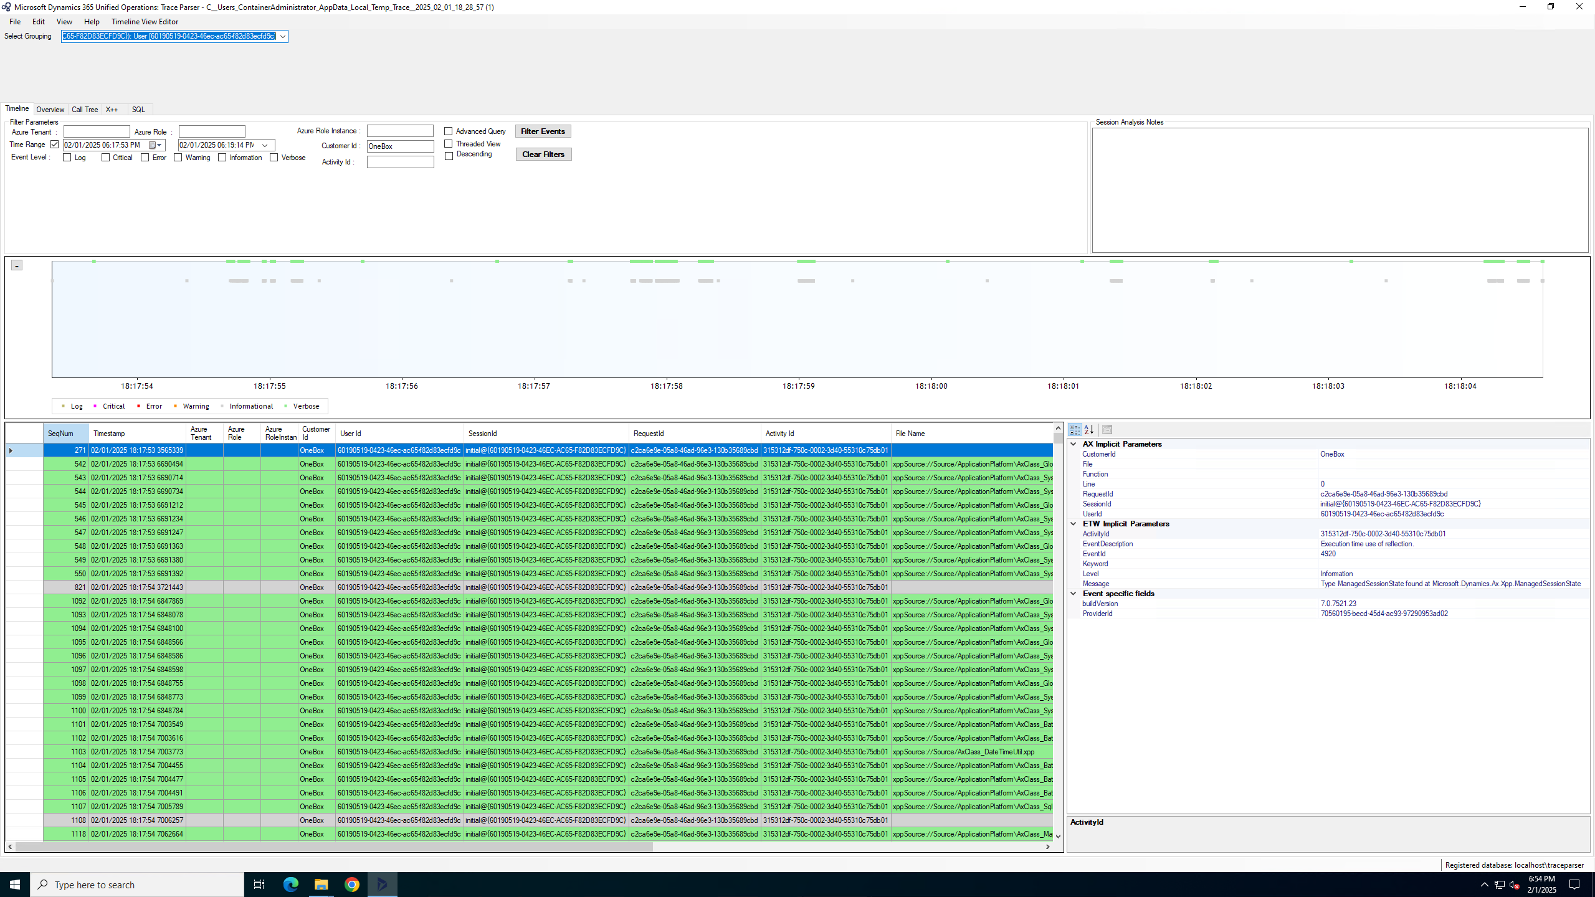

Slide 48
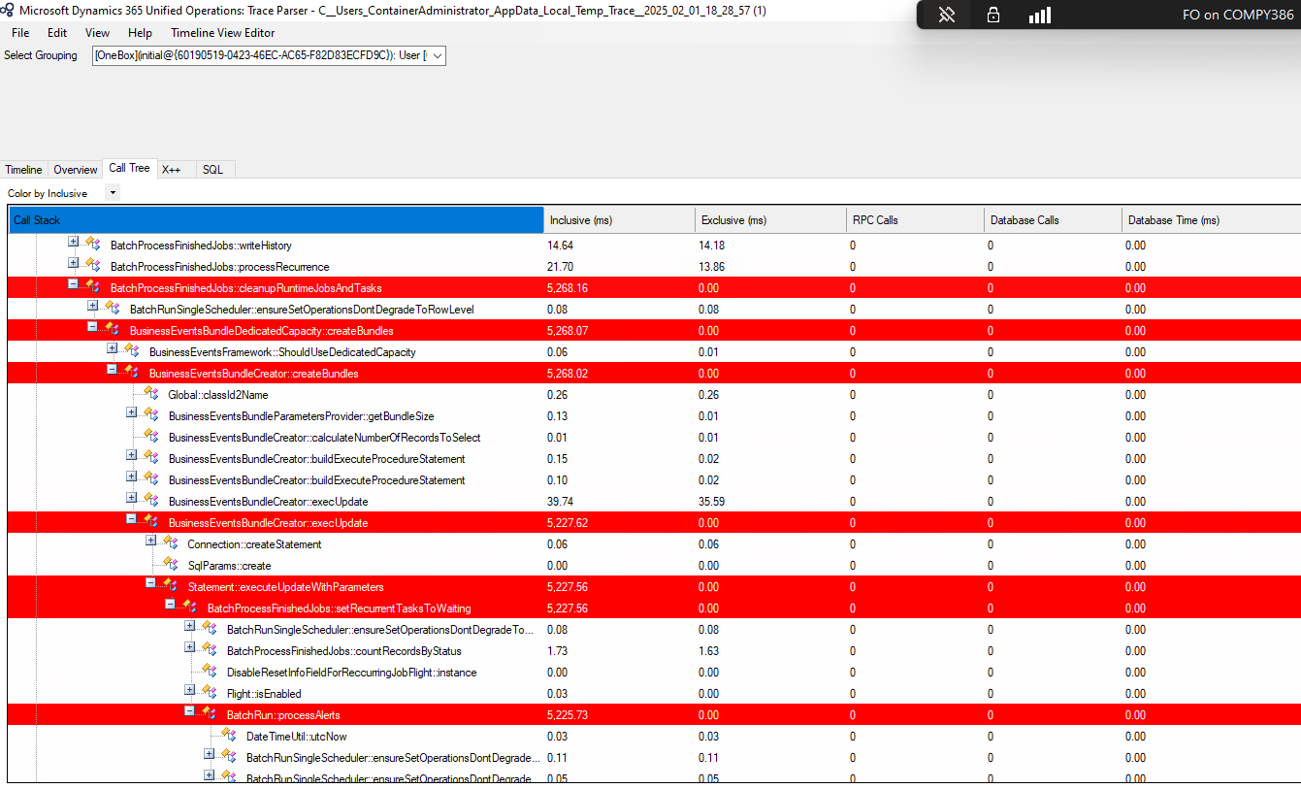

Slide 49
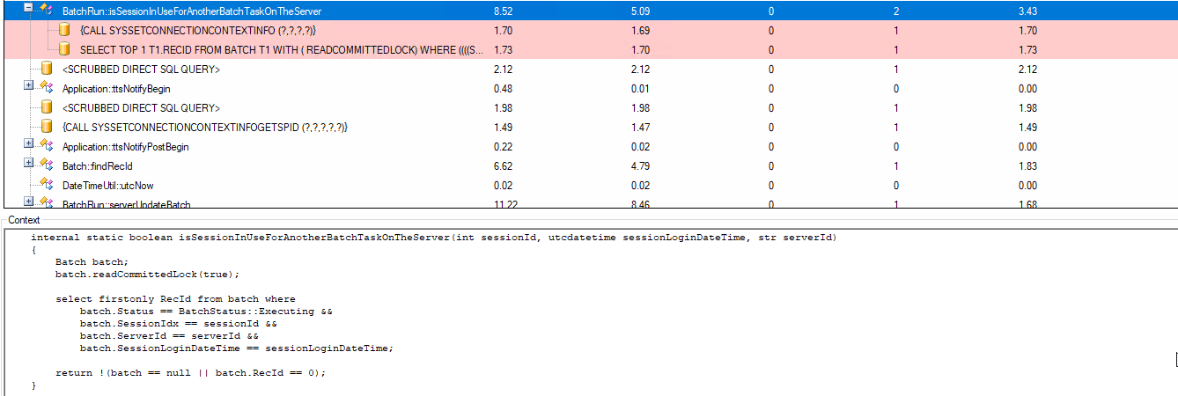

Slide 50
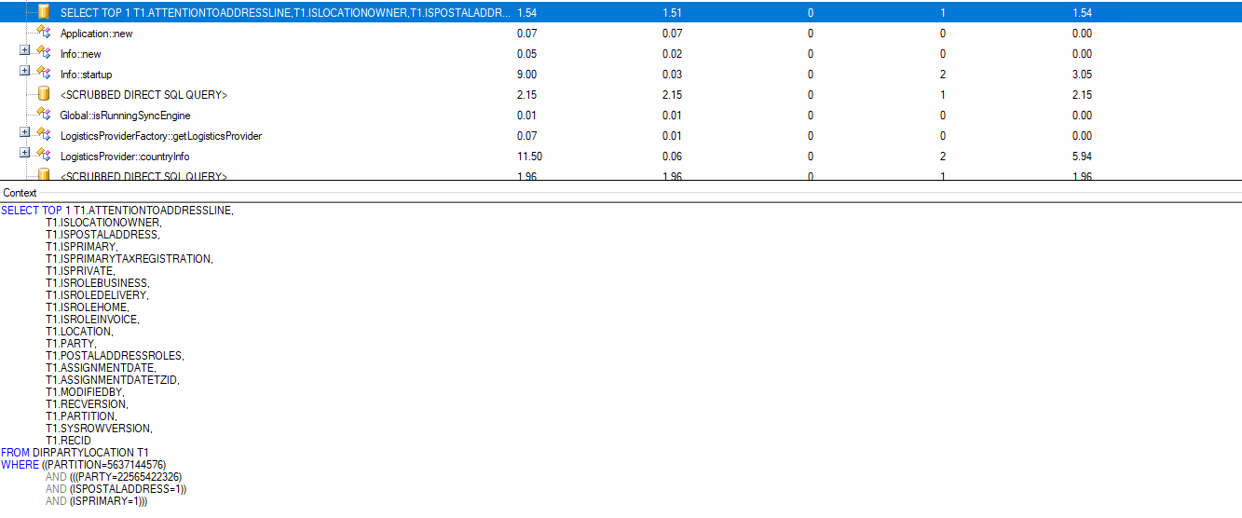

Slide 51
Common Problems
Poor Indexing of Tables
Missing Indexes / Indices
Not using indexes ( customizations )
Poor loop architectures

Slide 52
Batch Jobs
Stagger
Tweak
Rewrite

Slide 53
Stagger
Move batch job times
Invoice after hours
Run reports in the middle of the night
Determine order of operations
What needs to happen on transaction date
What needs to happen before the next day

Slide 54
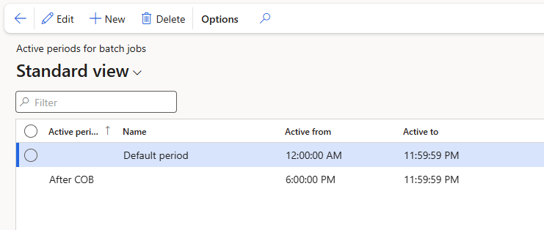

Slide 55
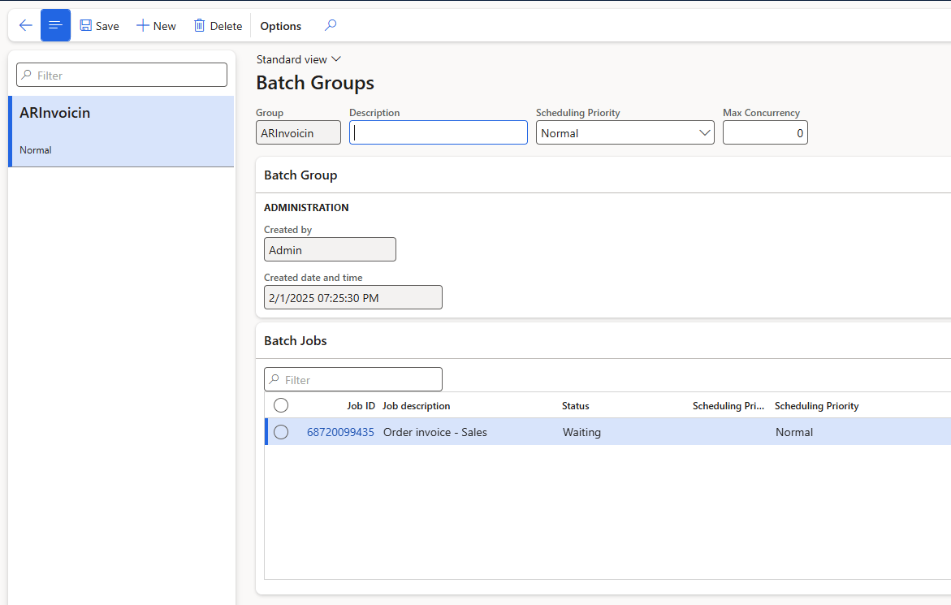

Slide 56
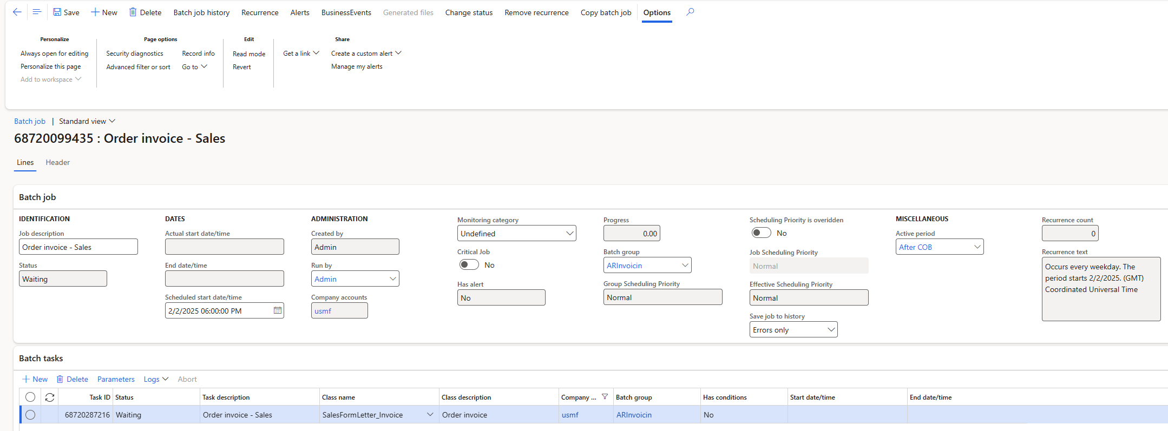

Slide 57
Tweak
Some batch jobs have new settings
Max threads
Bundle size
Etc.
New Features
Filter on “performance” in Feature Management workspace

Slide 58
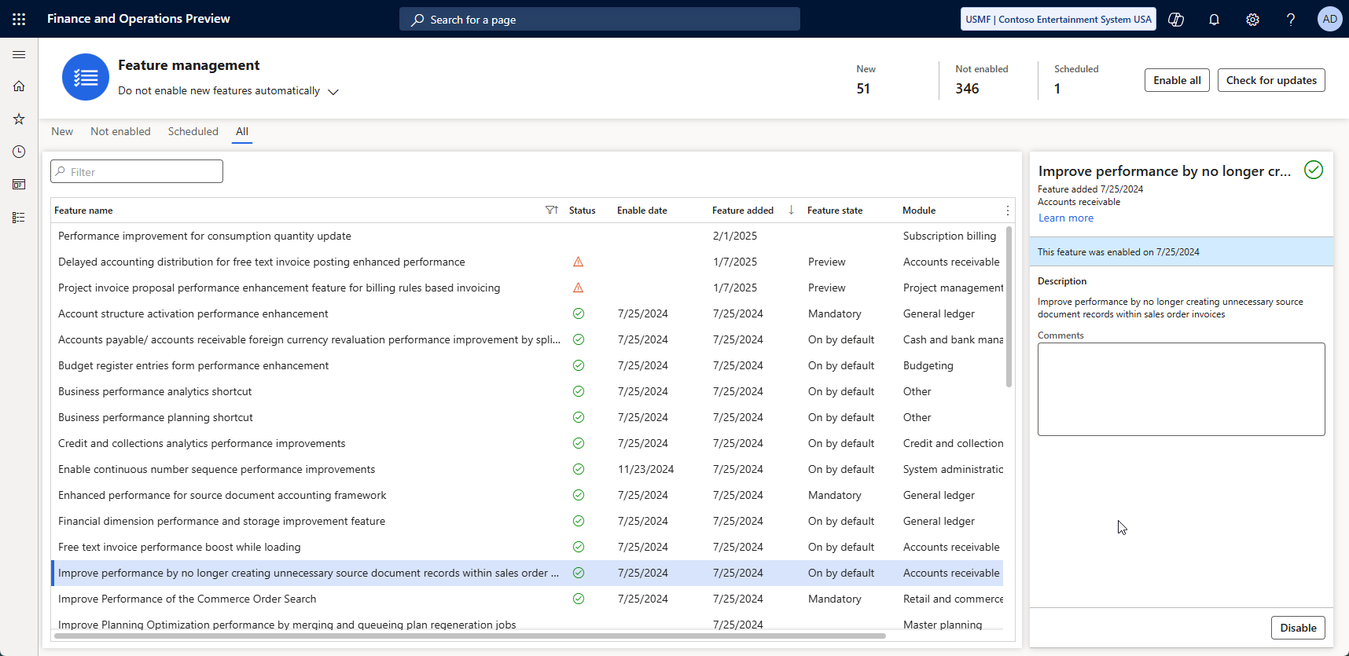

Slide 59
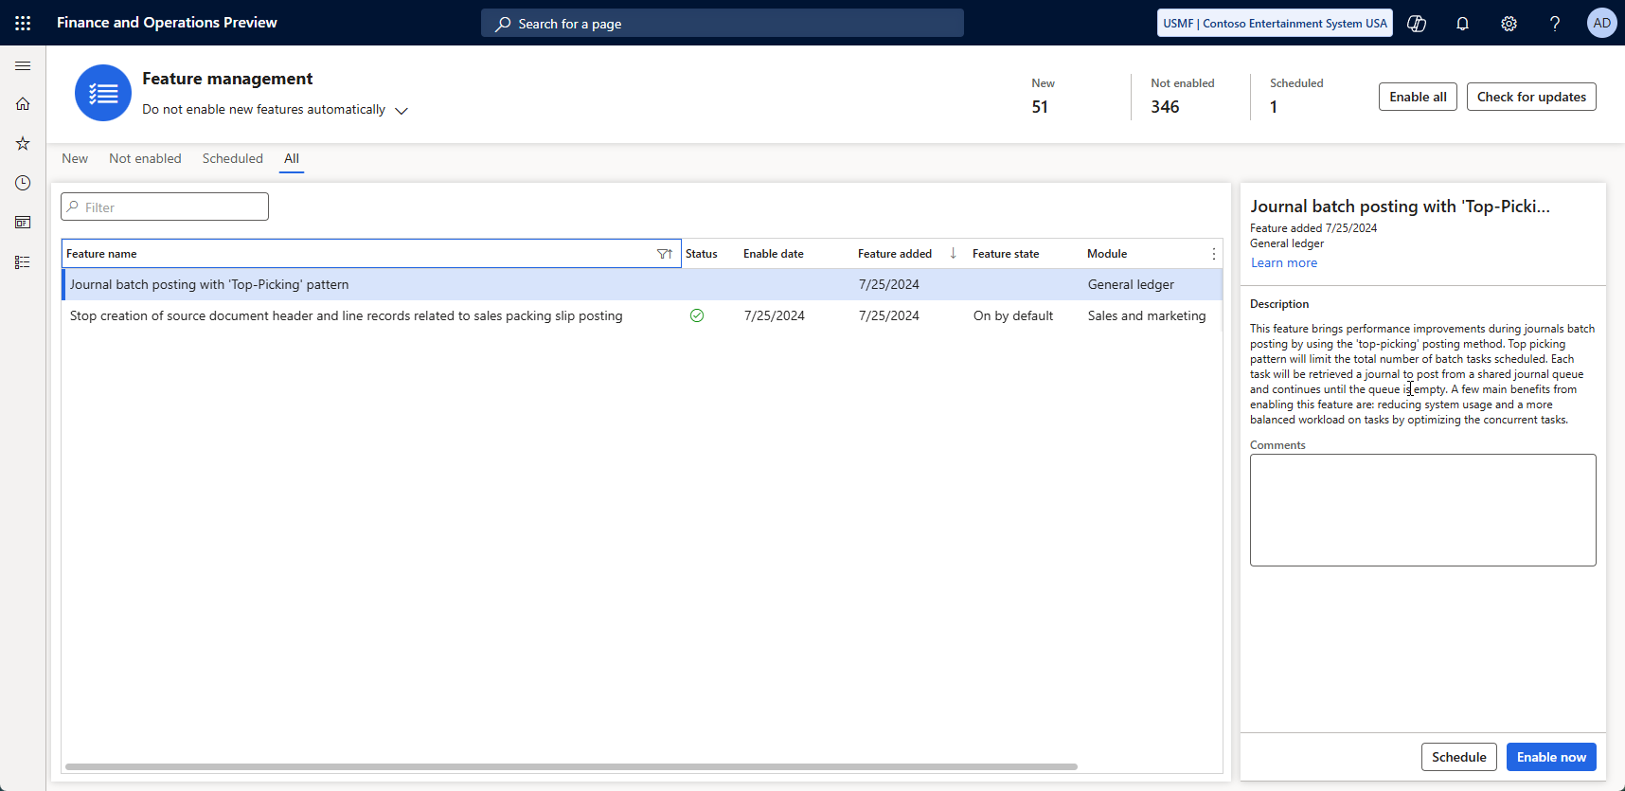

Slide 60
Tweak
Use Cleanup Batch jobs
Go to module > expand all > search for “Cleanup” or “clean”

Slide 61
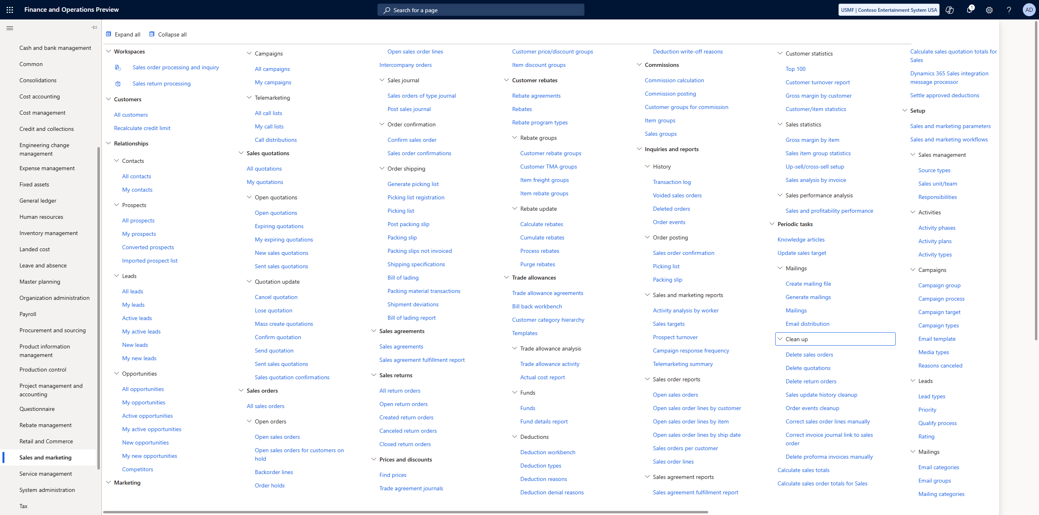

Slide 63
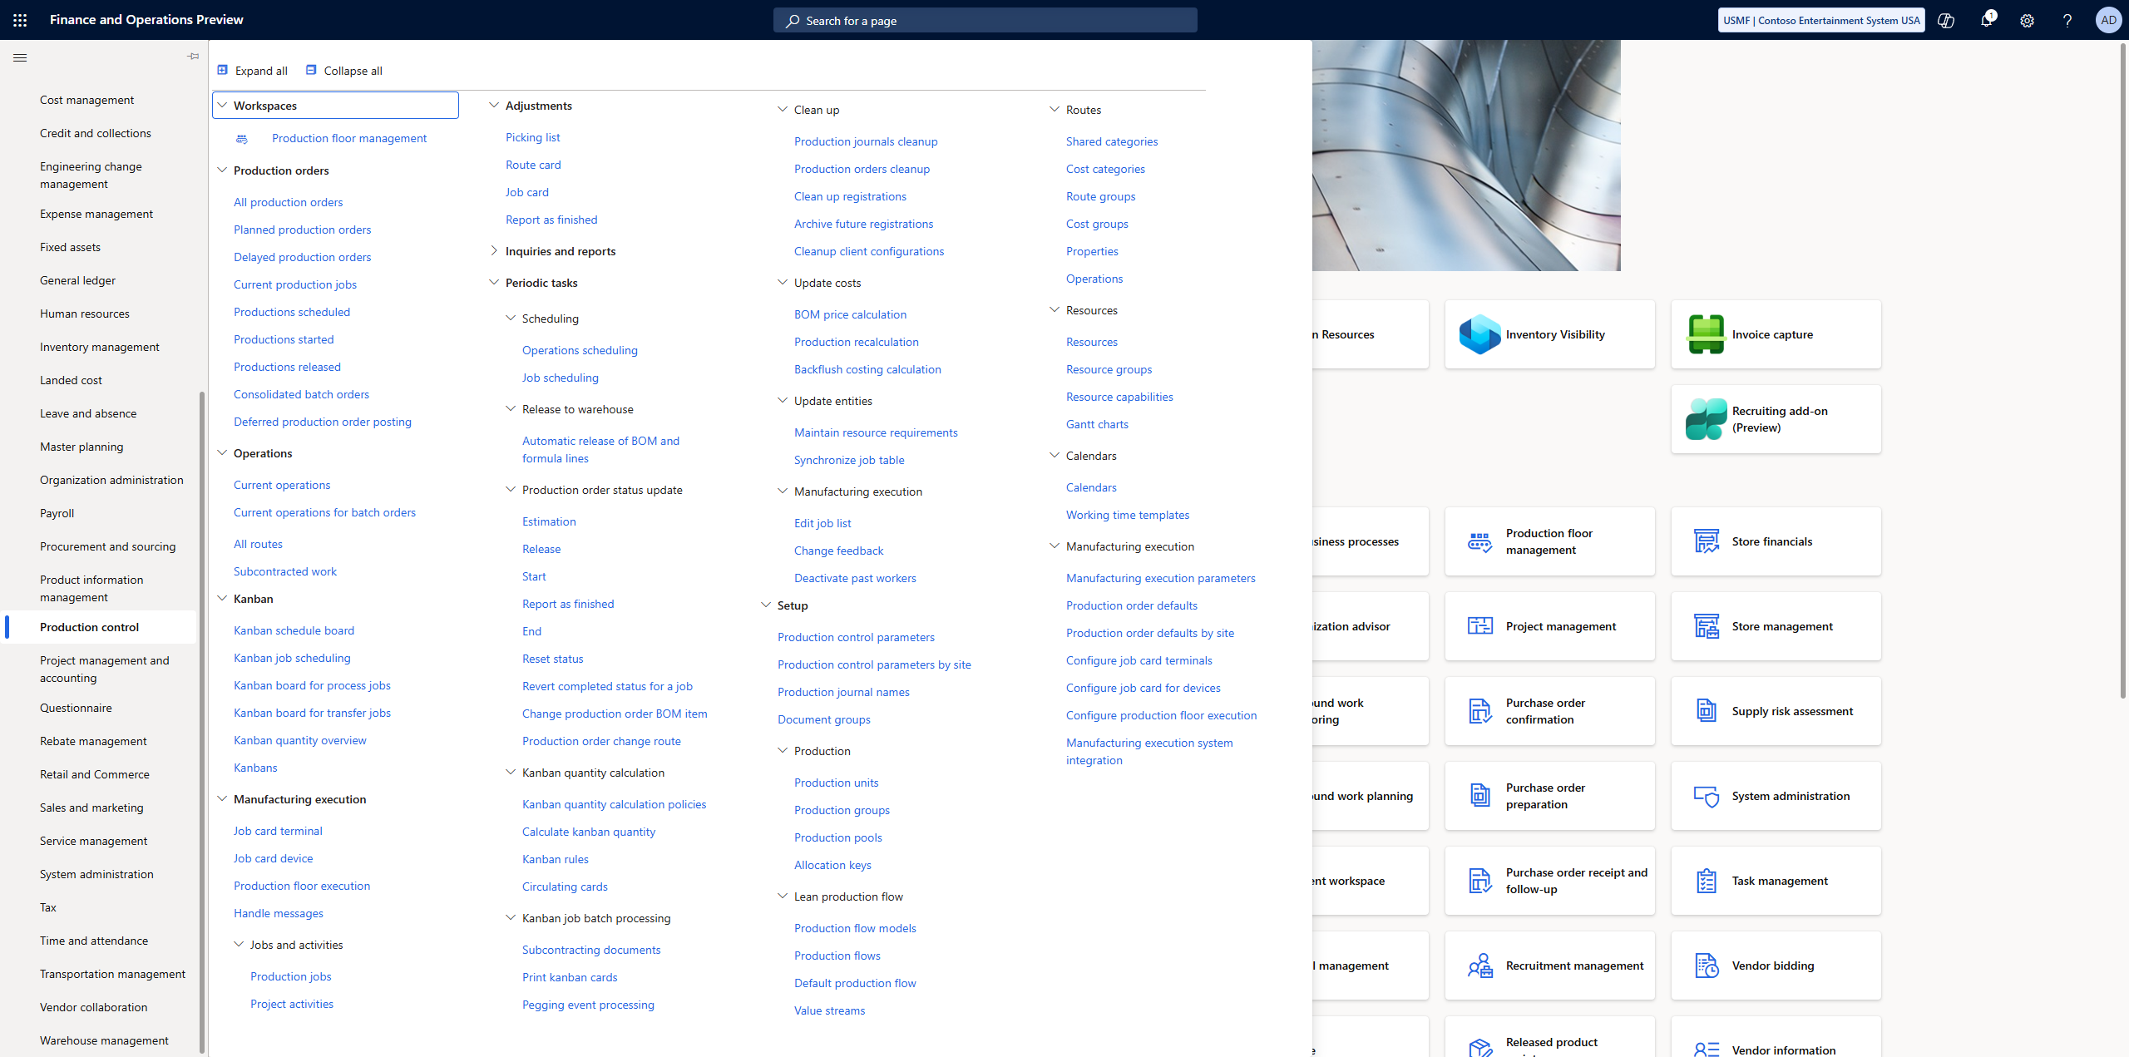

Slide 65
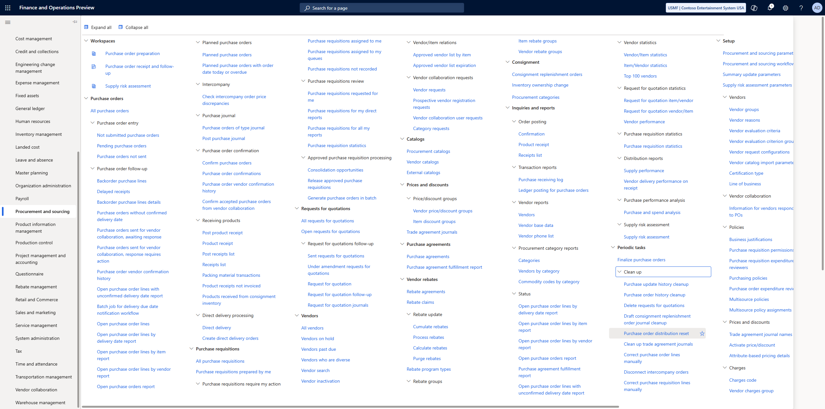

Slide 67
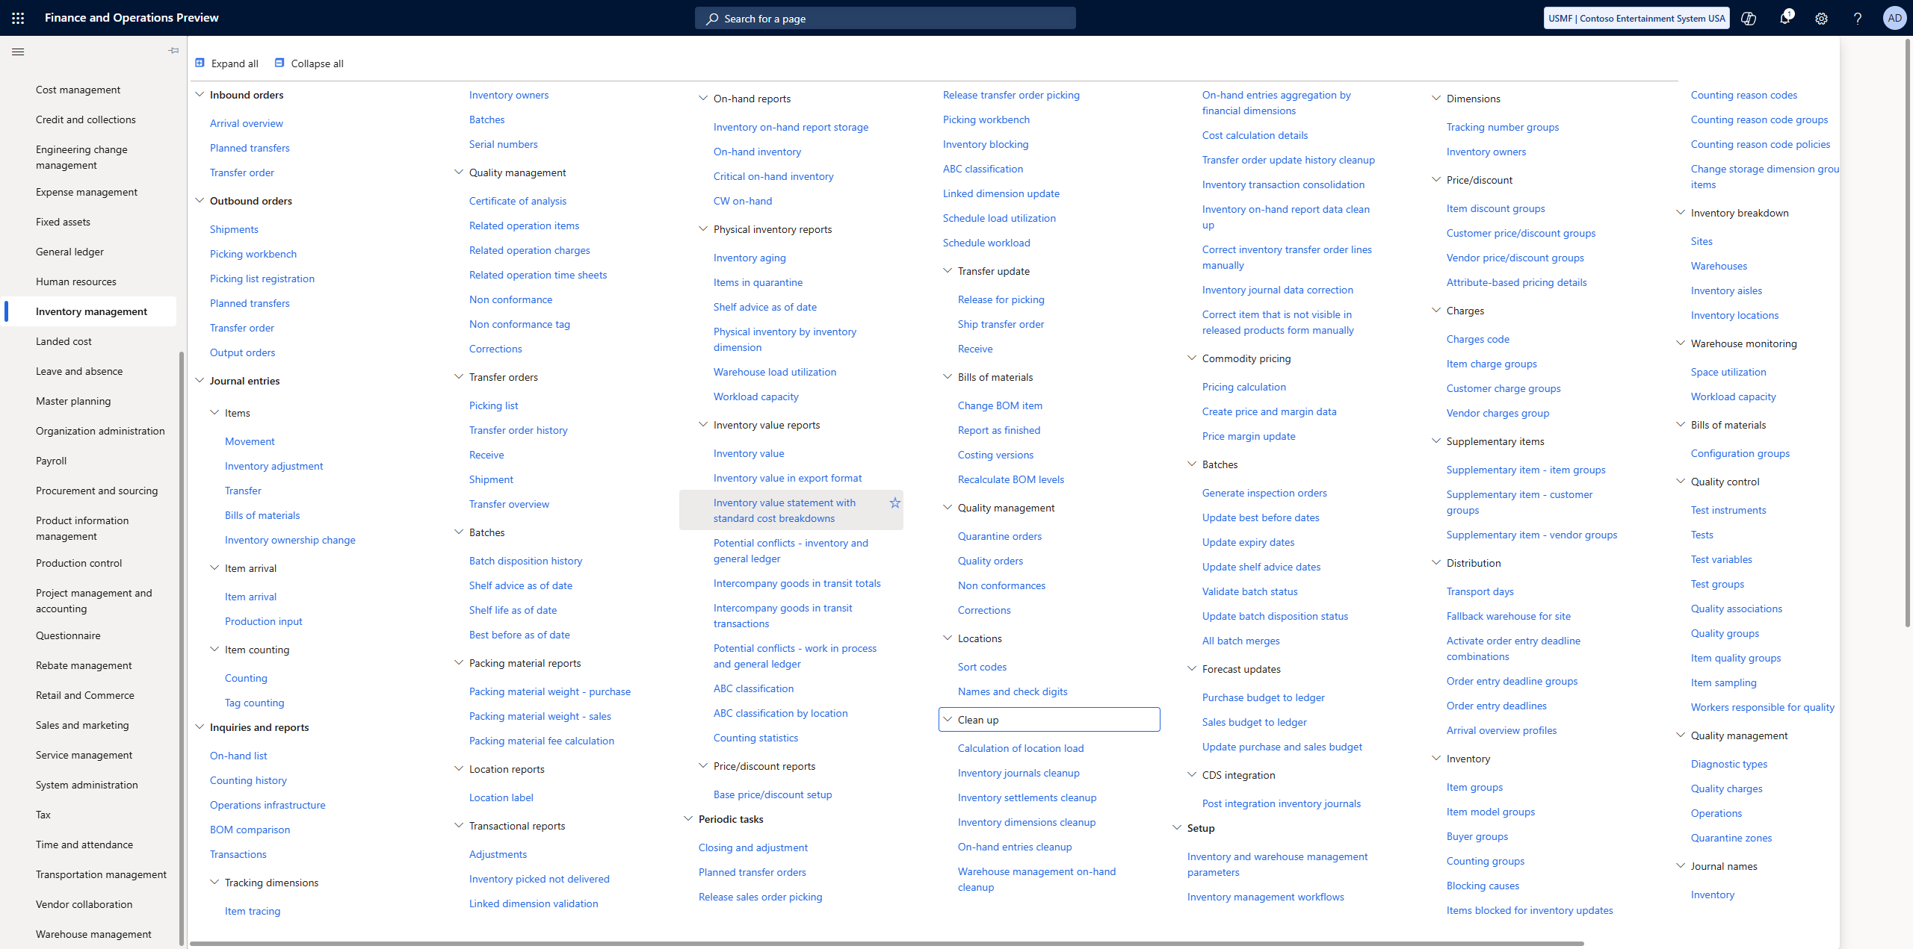

Slide 69
Custom Batch Jobs
“Classic” Batch Job
Individual Task Model
Batch-Bundle
Top-Picking
Each type has pros and cons

Slide 70
Custom Batch Jobs
Classic batch job
Slow but cheap
Single Threaded
Tried-and-True method that works
Individual Task Model
Fast but expensive
“all threaded”
Schedule everything and let batch sort it out

Slide 71
Custom Batch Jobs
Batch-Bundle
Moderate to Fast with some cost
Groups of tasks
Groups get completed 1 group at a time with multiple groups running at a time
Top-Picking
Fast with some temporal cost
“x threaded”
Setup x number of threads / lanes to execute all the work

Slide 72
Data Entities Have A Similar Problem
Data entities from Microsoft are built for the world
Maybe not for you
Includes specializations in all countries Microsoft supports

Slide 73
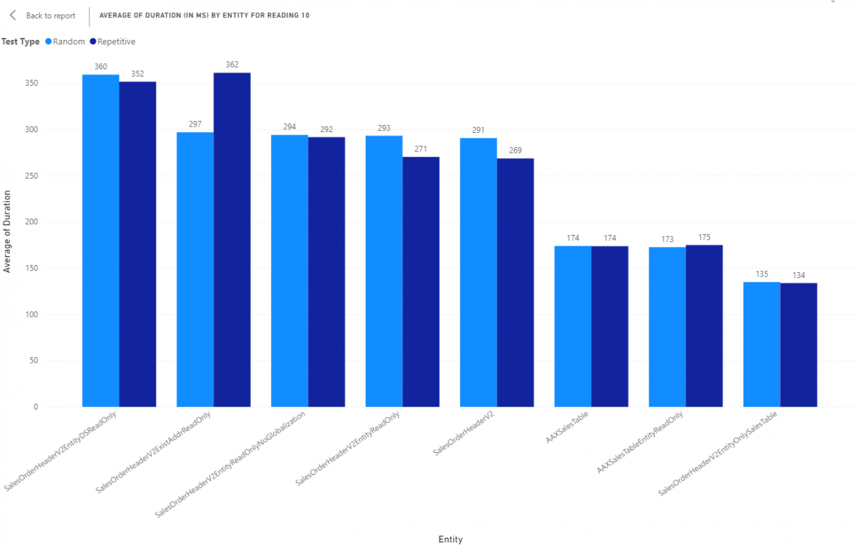

Slide 74
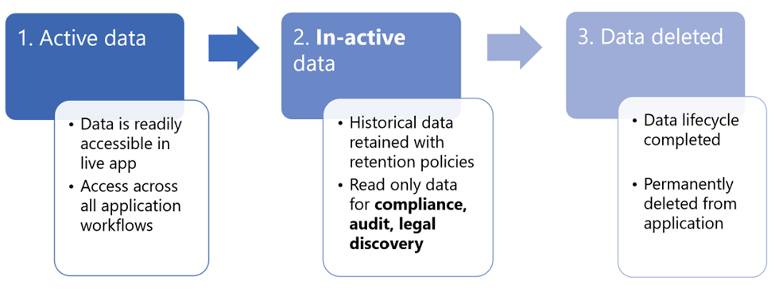
Archive If you Can

Slide 75
Archive If you Can
Currently Supported
Dynamics 365 Finance General ledger
Dynamics 365 Finance Tax transactions
Dynamics 365 Supply Chain Management Inventory transactions
Dynamics 365 Supply Chain Management Inventory journals
Dynamics 365 Supply Chain Management Sales orders
https://www.youtube.com/watch?v=wbZ-g4AGjc4

Slide 76
Archive Callouts
The long term-retained data is read-only.
The X++ delete action isn't honored when a data archival policy is run to move data out of the live finance and operations database
Finance and operations attachments aren't currently supported
The archival process for scenarios that involve Dataverse long term retention has multiple stages that run sequentially in the background. The process can take up to 14 days.
The archived data in Dataverse long term retention can't be moved back to the live application table

Slide 77





Key Takeaways
Personalize screens and workspaces for your specific workload and remove unused fields
Explore new product offerings from Microsoft like data entities, features, misc.
Document and report slow processes for admins and developers to review
Use Batch, if possible, with alerts and workspaces to focus on completing tasks and highlighting work left to complete

Slide 78
Key Takeaways
Review processes for performance issues using traces. Report to Microsoft if internal problem or developers if a customization problem
Review database indexes ( if possible and appropriate )
Customize with targeted batch jobs if needed
Customize for high performance ( if needed )

Slide 79
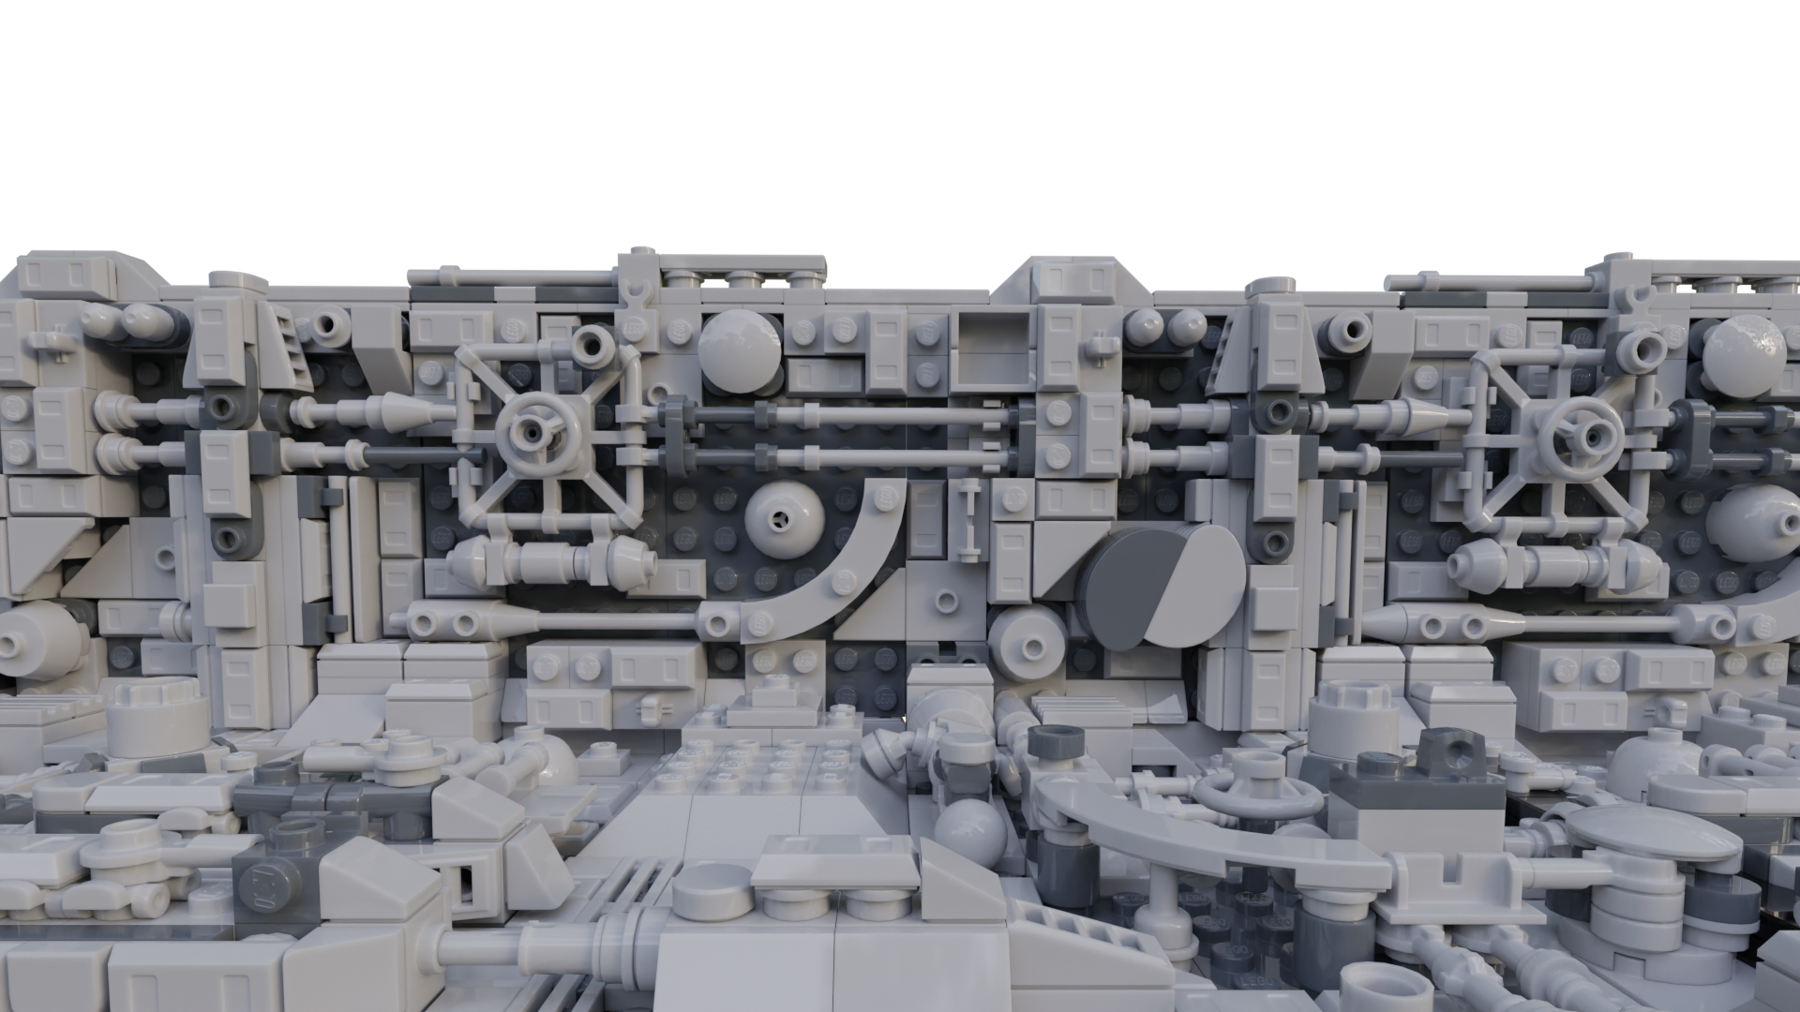
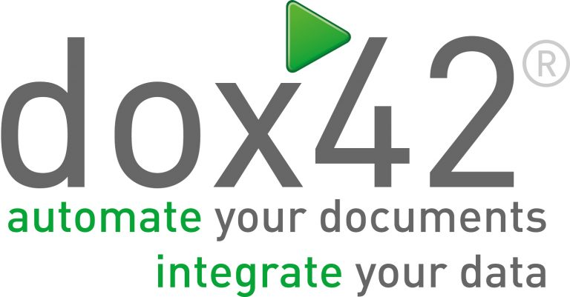






Sponsors
THANK
YOU!

